Slide 1

Project Report

Slide 2
Aim
Help Future Group identify
Target Market of each store and product
Existing Consumer Segment of each product
Demand of Food Products in every store-location
New store-locations
Better pricing strategy for existing and new stores

Slide 3
How ?
Analyse the demographic distribution of the residents in the neighbourhood of a store
Estimate the expenditure pattern and wealth index of the region
Identify the food product requirements of the region
External Data
Internal Data
Function
Better Predictions
Better Analysis

Slide 4
Identify the locations of 6 Easy Day Stores.
City | Store ID | Address | Place
New Delhi | 110018 | L29, LOK NATH MARG | Kirti Nagar
New Delhi | 110018 | Block F/ 123 Vikaspuri | Vikaspuri
New Delhi | 11085 | C2/8 | Prashant Vihar
New Delhi | 11075 | Plot #11,12,16,17 Palam Extn. | Dwarka Sector-7
New Delhi | 11058 | B3/178 Janakpuri | Janakpuri
New Delhi | 11092 | MB 158 159 Master Block | Madhuban

Slide 5
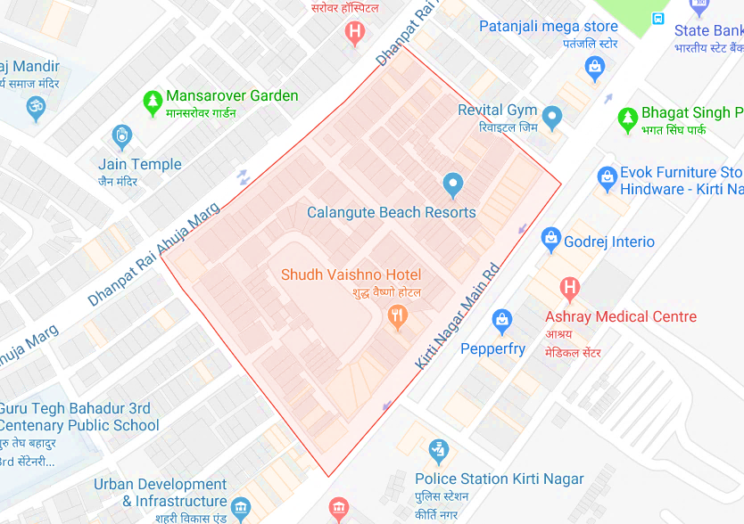
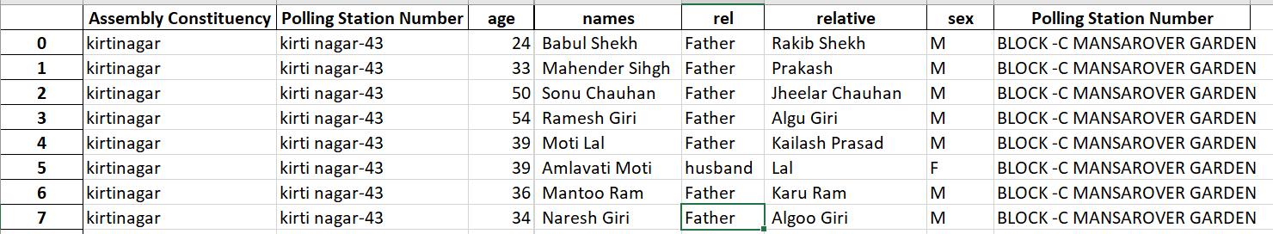
Finding the customer
Location : Kirti Nagar
Get a list of people living in the catchment area as defined for the store location.
Obtain the names ,age ,sex
Data Source – Electoral Rolls

Slide 6
Demography Analysis
What we can understand ?
Gender Ratio
Age Groups
Community Distribution
Religion Distribution
Electoral Rolls of the Catchment Areas

Slide 7
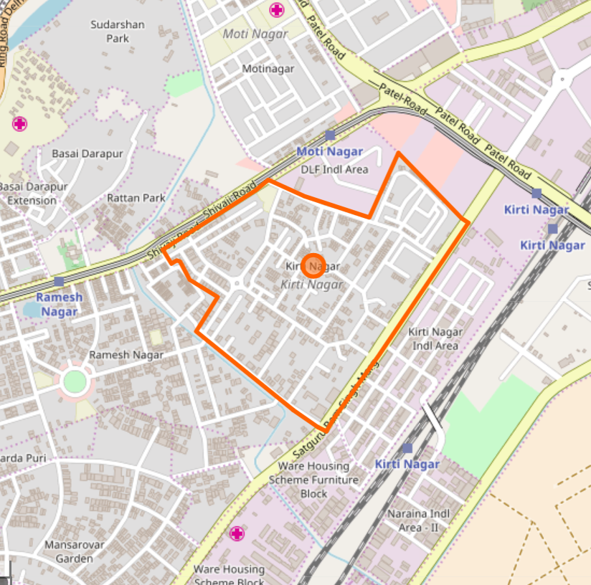
Store ID - 110018
Catchment Area
Time Series
Product Age Distribution
Sub-Category Gender Distribution
Kirti Nagar

Slide 8

Prediction Model
F(a, b, c)
Religion
Community
First Name + Surname + Location
Initial Classification
Child name websites
Matrimonial websites
FG Group Loyalty data
Region Type
Naive Bayes Classifier
Predictions

Slide 9
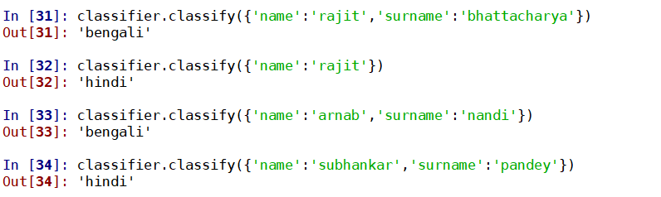
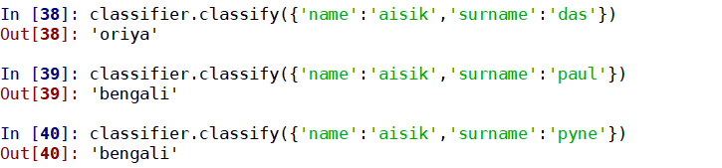
Examples of Classification
82% accuracy achieved using existing model

Slide 10
Store ID - 110018
Catchment Area
Kirti Nagar

Slide 11
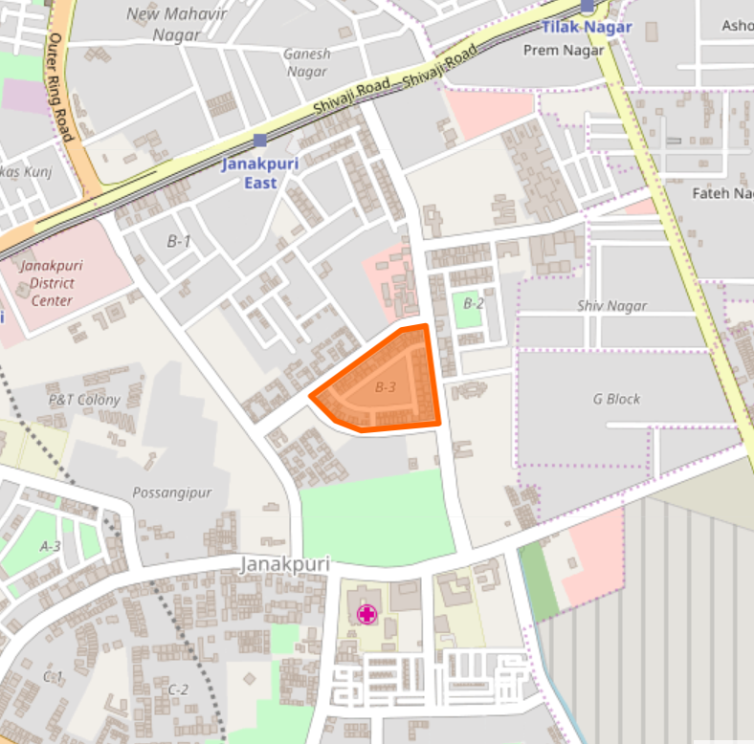
Store ID - 11058
Catchment Area
Janakpuri

Slide 12
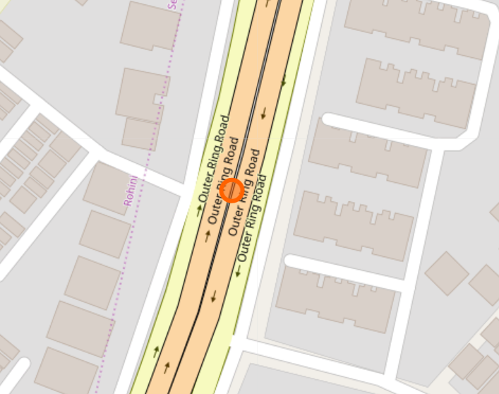
Store ID - 11085
Catchment Area
Prashant Vihar

Slide 13
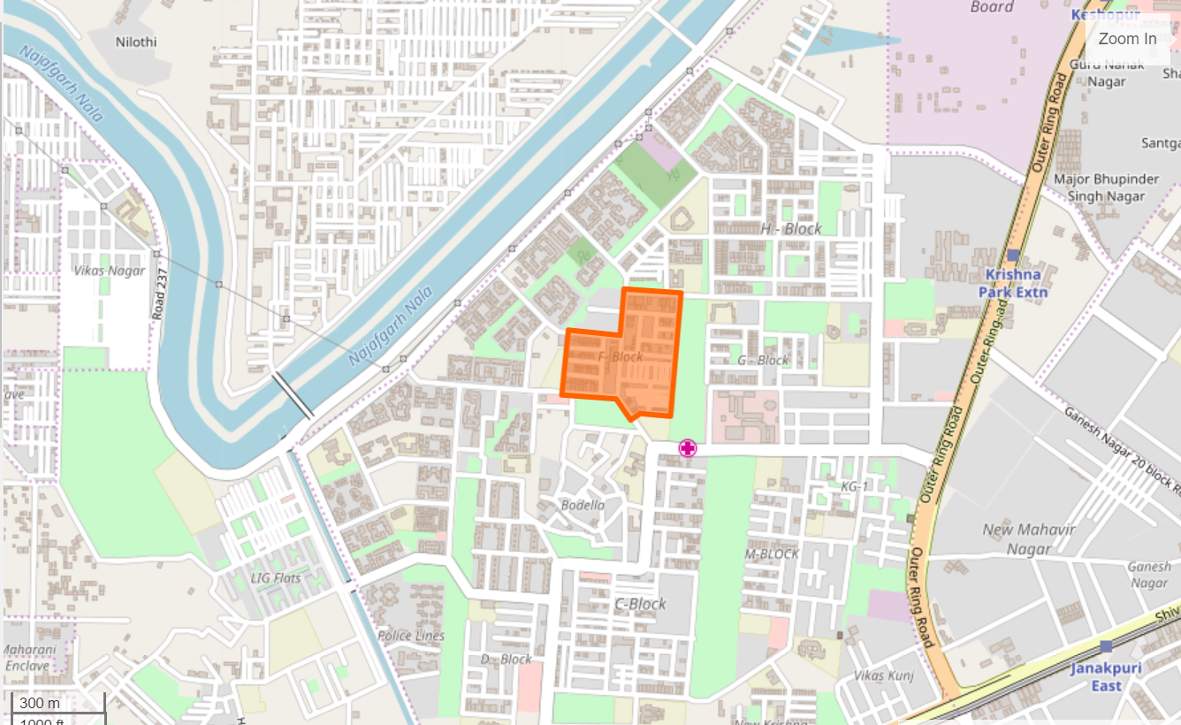
Store ID - 110018
Catchment Area
Vikaspuri

Slide 14
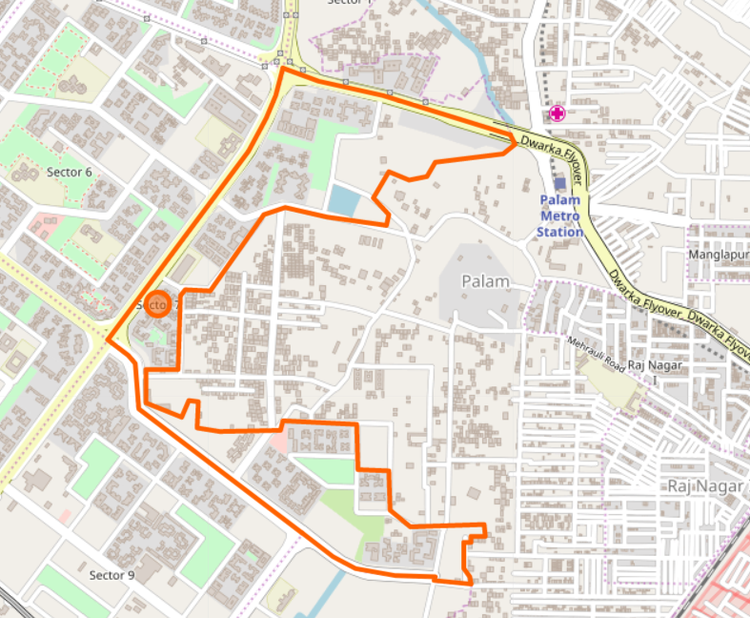
Store ID - 11075
Catchment Area
Dwarka Sector-7

Slide 15
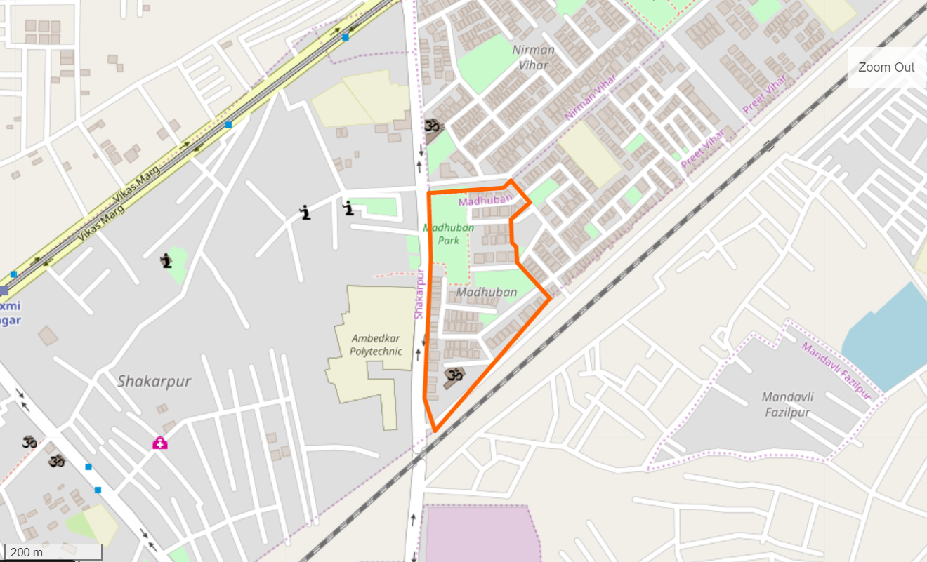
Store ID - 11092
Catchment Area
Madhuban

Slide 16
Validation
Census 2011 Tables
However, classification prediction would give a far more accurate picture because of migration trends over time.

Slide 17

How will this help ?
Identify your target market
Which product caters more to which Age Group
Which product caters more to which Gender?
Which product caters more to which Religion Group?
Which product caters more to which Community Group?
Demography Analysis
Internal Sales Data
Form Customer Clusters and map to products

Slide 18
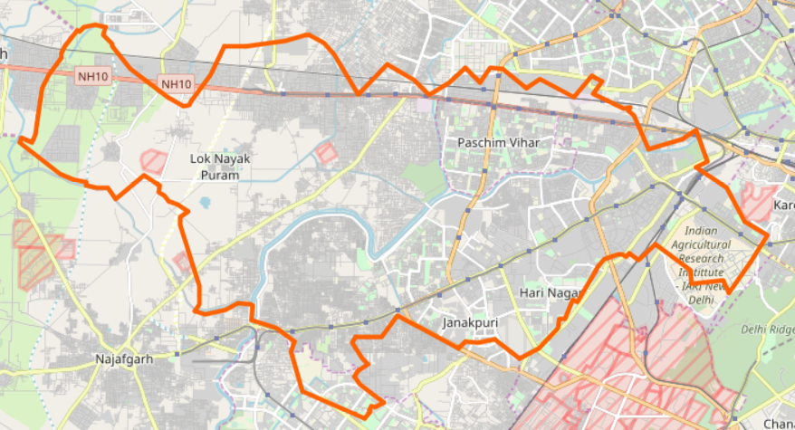
Ingredient Distribution
Predicting food ingredient demand location-wise
Select Location
Get Religion & Community Mix
Obtain Ingredient Map of Place

Slide 19
Food Map of India
Community vs Cuisine vs Ingredient
Ingredient | Bengali | Gujarati | Marwari | Punjabi | South Indian
Black Pepper | 0.003077 | 0.004597 | 0.003989 | 0.000704 | 0.007808
Chana Dal | 0.002051 | 0.002758 | 0.005186 | 0.002499 | 0.020095
Milk | 0.047692 | 0.012085 | 0.016422 | 0.016695 | 0.010239
Curd | 0.014872 | 0.025483 | 0.022904 | 0.023282 | 0.013828
Cheese | 0.015385 | 0.003153 | 0.005618 | 0.02385 | 0.003328
Recipe websites
Cookbooks
Bag of Words
Observing consumption patterns will help us market products to locations based on community distribution.

Slide 20
Eating-out Habits
Identify cuisines of restaurants, food joints in catchment area.
Find popularity of these restaurants, food joints.
Zomato-like
sites
Formulate Cuisine Distribution of Catchment Areas

Slide 21
Eating-out Habits
Finding existing preferred cuisines in locations of the stores

Slide 22
Eating-out Habits
Finding existing preferred cuisines in locations of the stores

Slide 23
How will this help ?
Ingredient-community distribution
Predict demand of Food Items sold in Easy Day stores.
Community & religion distributions
Existing product-wise sales data of stores
Eating-out habits in around store locations

Slide 24
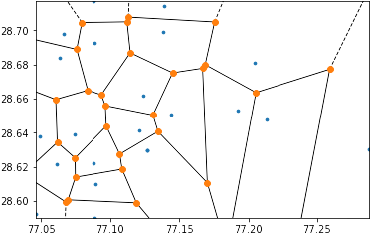
Voronoi Diagram
Identify points in West & North-west Delhi surrounding the 6 store-locations with distinct land rates
Latitude
Form the Voronoi Diagram based on the points
Smoothen the area using Gaussian Filter.
Incorporate residential factor & wealth index from Asset Data in Census 2011.
Longitude

Slide 25
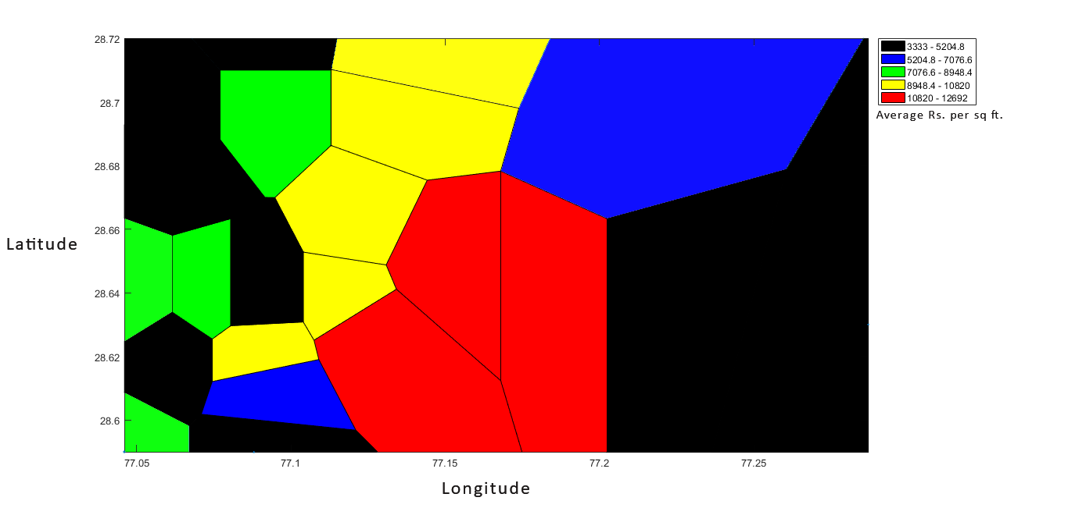
Breaking the region surrounding the 6 stores into 5 economic zones

Slide 26
F(Asset Value, Percentage of Households, Land Rate)
Wealth Index
Property Rates
Rental Rates
Asset Data
Residential Zones
Property
Sites
Formulate Wealth Index of a place
Identify Residential Zones
Census
2011

Slide 27
How will this help ?
Wealth Index
Residential Zones
F(a, b)
Predict price range of products more suitable for store location in a catchment area.
Internal Sales Data
Profit Percentage of products

Slide 28
Thank You
Rajit Bhattacharya
Aisik Paul
Ankit Das
Aditya Chowdhury

